Slide 1
Evaluation Metrics for Ranking Problems
(2020.04.13, Queirozf)
Yang Xi’s Reading Note
Reference:
https://queirozf.com/entries/evaluation-metrics-for-ranking-problems-introduction-and-examples
https://en.wikipedia.org/wiki/Discounted_cumulative_gain

Slide 2
Ranking Problems
The order of predictions does matter
Classification problems can be turned into ranking problems
Contents
Precision @k, Recall @k, F1 @k
Average Precision (AP), Mean Average Precision (MVP)
Normalized Discounted Cumulative Gain (NDGC) – work for continuous values

Slide 3
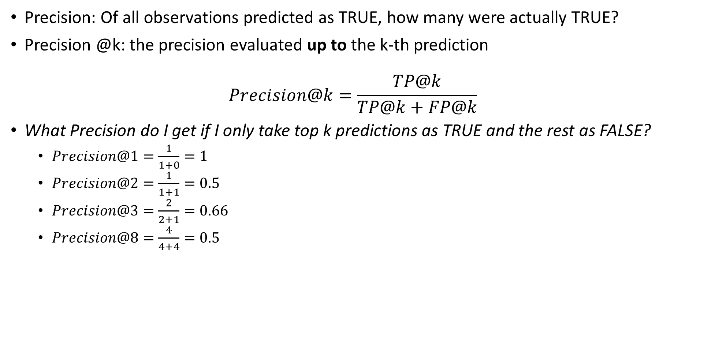
Precision @k
Precision: Of all observations predicted as TRUE, how many were actually TRUE?
Precision @k: the precision evaluated up to the k-th prediction $Precision@k=\frac{TP@k}{TP@k+FP@k}$
What Precision do I get if I only take top k predictions as TRUE and the rest as FALSE?
$Precision@1=\frac{1}{1+0}=1$
$Precision@2=\frac{1}{1+1}=0.5$
$Precision@3=\frac{2}{2+1}=0.66$
$Precision@8=\frac{4}{4+4}=0.5$
k | Doc ID | Predicted Relevance | Actual Relevance | Precision @k
1 | 06 | 0.90 | 1 | 1.0
2 | 03 | 0.85 | 0 | 0.50
3 | 05 | 0.71 | 1 | 0.66
4 | 00 | 0.63 | 1 | 0.75
5 | 04 | 0.47 | 0 | 0.60
6 | 02 | 0.36 | 1 | 0.66
7 | 01 | 0.24 | 0 | 0.57
8 | 07 | 0.16 | 0 | 0.50

Slide 4
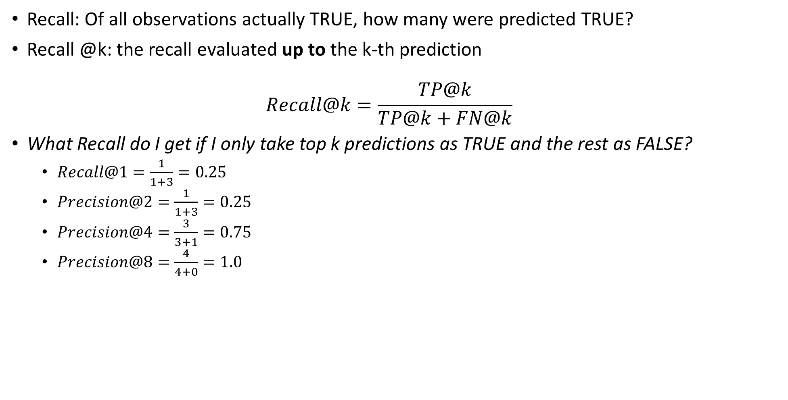
Recall @k
Recall: Of all observations actually TRUE, how many were predicted TRUE?
Recall @k: the recall evaluated up to the k-th prediction $Recall@k=\frac{TP@k}{TP@k+FN@k}$
What Recall do I get if I only take top k predictions as TRUE and the rest as FALSE?
$Recall@1=\frac{1}{1+3}=0.25$
$Precision@2=\frac{1}{1+3}=0.25$
$Precision@4=\frac{3}{3+1}=0.75$
$Precision@8=\frac{4}{4+0}=1.0$
k | Doc ID | Predicted Relevance | Actual Relevance | Precision @k | Recall @k
1 | 06 | 0.90 | 1 | 1.0 | 0.25
2 | 03 | 0.85 | 0 | 0.50 | 0.25
3 | 05 | 0.71 | 1 | 0.66 | 0.5
4 | 00 | 0.63 | 1 | 0.75 | 0.75
5 | 04 | 0.47 | 0 | 0.60 | 0.75
6 | 02 | 0.36 | 1 | 0.66 | 1.0
7 | 01 | 0.24 | 0 | 0.57 | 1.0
8 | 07 | 0.16 | 0 | 0.50 | 1.0

Slide 5

F1 @k
F1: A mixed metrics that takes into account both Precision and Recall
F1 @k: the F1 evaluated up to the k-th prediction $F1@k=2∙\frac{Precision@k∙Recall@k}{Precision@k+Recall@k}$
What F1 do I get if I only take top k predictions as TRUE and the rest as FALSE?
k | Doc ID | Predicted Relevance | Actual Relevance | Precision @k | Recall @k | F1 @k
1 | 06 | 0.90 | 1 | 1.0 | 0.25 | 0.4
2 | 03 | 0.85 | 0 | 0.50 | 0.25 | 0.33
3 | 05 | 0.71 | 1 | 0.66 | 0.5 | 0.62
4 | 00 | 0.63 | 1 | 0.75 | 0.75 | 0.75
5 | 04 | 0.47 | 0 | 0.60 | 0.75 | 0.66
6 | 02 | 0.36 | 1 | 0.66 | 1.0 | 0.80
7 | 01 | 0.24 | 0 | 0.57 | 1.0 | 0.73
8 | 07 | 0.16 | 0 | 0.50 | 1.0 | 0.66

Slide 6
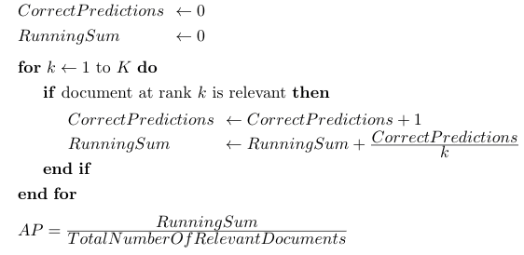

Average Precision (AP)
AP tells you how much of the relevant documents are concentrated in the highest ranked predictions $AP=\sum_{K}{[\left(Recall@k−Recall@\left[k−1\right]\right)∙Precision@k]}$
The formular cannot start without Recall @0. So you can use the algorithm on the right
k | Doc ID | Predicted Relevance | Actual Relevance | Precision @k | Recall @k | F1 @k | Correct Predictions | Running Sum | AP
1 | 06 | 0.90 | 1 | 1.0 | 0.25 | 0.4 | 1 | 1 | 1
2 | 03 | 0.85 | 0 | 0.50 | 0.25 | 0.33 | 1 | 1 | 1
3 | 05 | 0.71 | 1 | 0.66 | 0.5 | 0.62 | 2 | 1.67 | 0.84
4 | 00 | 0.63 | 1 | 0.75 | 0.75 | 0.75 | 3 | 2.42 | 0.81
5 | 04 | 0.47 | 0 | 0.60 | 0.75 | 0.66 | 3 | 2.42 | 0.81
6 | 02 | 0.36 | 1 | 0.66 | 1.0 | 0.80 | 4 | 3.08 | 0.77
7 | 01 | 0.24 | 0 | 0.57 | 1.0 | 0.73 | 4 | 3.08 | 0.77
8 | 07 | 0.16 | 0 | 0.50 | 1.0 | 0.66 | 4 | 3.08 | 0.77
No change, because document at the rank is not relevant

Slide 7
Mean Average Precision (MAP)
MAP is simply the average AP of all observations

Slide 8

Discounted Cumulative Gain (DCG)
DCG can work if the relevance values are real number (a relevance score) $DCG@k=\sum_{i=1}^{k}{\frac{2^{rel_{i}}−1}{\log_{2}{(i+1)}}}$
$rel_{i}$ is the relevance score of document at index $i$.
This formulation strongly emphasis on retrieving relevant documents, which is popular in web companies.
In our example, we continue to use the binary values.
Obviously, larger result sets trend to have higher DCG score./ As a result, DCG cannot be used to evaluate performance of a ranking model on a whole validate dataset.
k | Doc ID | Predicted Relevance | Actual Relevance | Precision @k | Recall @k | F1 @k | AP | DCG @ k
1 | 06 | 0.90 | 1 | 1.0 | 0.25 | 0.4 | 1 | 1.0
2 | 03 | 0.85 | 0 | 0.50 | 0.25 | 0.33 | 1 | 1.0
3 | 05 | 0.71 | 1 | 0.66 | 0.5 | 0.62 | 0.84 | 1.5
4 | 00 | 0.63 | 1 | 0.75 | 0.75 | 0.75 | 0.81 | 1.93
5 | 04 | 0.47 | 0 | 0.60 | 0.75 | 0.66 | 0.81 | 1.93
6 | 02 | 0.36 | 1 | 0.66 | 1.0 | 0.80 | 0.77 | 2.29
7 | 01 | 0.24 | 0 | 0.57 | 1.0 | 0.73 | 0.77 | 2.29
8 | 07 | 0.16 | 0 | 0.50 | 1.0 | 0.66 | 0.77 | 2.29
Calculated with actual relevance

Slide 9

Normalized Discounted Cumulative Gain (NDCG)
Normalized DCG using IDCG: IDCG@k is the best possible value for DCG@k.
NDCG can be used to measure model performance across a full dataset – just take average. $NDCG@k=\frac{DCG@k}{IDCG@k}$ $IDCG@k=\sum_{i=1}^{\begin{aligned}relevant documents \\ at k\end{aligned}}{\frac{2^{rel_{i}}−1}{\log_{2}{(i+1)}}}$
To calculate IDCG, you need to sort all relevant documents by their relative relevance (descending) first:
k | Doc ID | Actual Relevance | IDCG @k
1 | 06 | 1 | 1
2 | 05 | 1 | 1.63
3 | 00 | 1 | 2.13
4 | 02 | 1 | 2.56
5 | 03 | 0 | 2.56
6 | 04 | 0 | 2.56
7 | 01 | 0 | 2.56
8 | 07 | 0 | 2.56
k | Doc ID | Predicted Relevance | Actual Relevance | Precision @k | Recall @k | F1 @k | AP | DCG @ k | IDCG @k | NDCG @k
1 | 06 | 0.90 | 1 | 1.0 | 0.25 | 0.4 | 1 | 1.0 | 1 | 1.0
2 | 03 | 0.85 | 0 | 0.50 | 0.25 | 0.33 | 1 | 1.0 | 1.63 | 0.61
3 | 05 | 0.71 | 1 | 0.66 | 0.5 | 0.62 | 0.84 | 1.5 | 2.13 | 0.7
4 | 00 | 0.63 | 1 | 0.75 | 0.75 | 0.75 | 0.81 | 1.93 | 2.56 | 0.75
5 | 04 | 0.47 | 0 | 0.60 | 0.75 | 0.66 | 0.81 | 1.93 | 2.56 | 0.75
6 | 02 | 0.36 | 1 | 0.66 | 1.0 | 0.80 | 0.77 | 2.29 | 2.56 | 0.89
7 | 01 | 0.24 | 0 | 0.57 | 1.0 | 0.73 | 0.77 | 2.29 | 2.56 | 0.89
8 | 07 | 0.16 | 0 | 0.50 | 1.0 | 0.66 | 0.77 | 2.29 | 2.56 | 0.89

Slide 10
Summary
Limitations of NDCG
For score systems like [2, 1, 0], NDCG does not penalize for bad documents in the result (1 1 1 and 1 1 1 0 are equally good).
For score systems like [1, 0, -1], NDCG can result in a negative value.
NDCG does not penalize for missing documents in the result (1 1 1 and 1 1 1 1 are equally good).

